Slide 1
Analyze an Algorithm
Mack 2023
Notes:
Last updated: 12-9-2022

Slide 2

Mystery code
Starter activity
def mystery(my_list, thing):
i = -1
num = 0
while num < len(my_list):
if my_list[num] == thing:
i = num
num = num + 1
return i
Question 1 What algorithm is this?
Question 2 What is the purpose of the variable i?
Question 3 How could this algorithm be improved?

Slide 3
Mystery code
Starter activity
def mystery(my_list, thing):
i = -1
num = 0
while num < len(my_list):
if my_list[num] == thing:
i = num
num = num + 1
return i
Question 1 What algorithm is this?
Answer Linear search.

Slide 4
Mystery code
Starter activity
def mystery(my_list, thing):
i = -1
num = 0
while num < len(my_list):
if my_list[num] == thing:
i = num
num = num + 1
return i
Question 2 Why is the variable i initialised to -1?
Answer The value -1 signifies the search item has not been found.

Slide 5
Mystery code
Starter activity
def mystery(my_list, thing):
i = -1
num = 0
while num < len(my_list):
if my_list[num] == thing:
i = num
num = num + 1
return i
Question 3 How could this algorithm be improved?
Answer A flag could be used to stop the while loop when an item is found. This could improve the algorithm’s efficiency by reducing the number of comparisons made.

Slide 6

Lesson 53: Algorithms review
Objectives
In this lesson, you will:
Interpret algorithms and suggest improvements
Analyse and fix errors in a flowchart
Perform searching and sorting algorithms on samples of data

Slide 7
Review lesson
Activity 1
In this lesson, you are going to review and practice different areas of the algorithms topic, including:
Flowcharts
Searching algorithms
Sorting algorithms

Slide 8

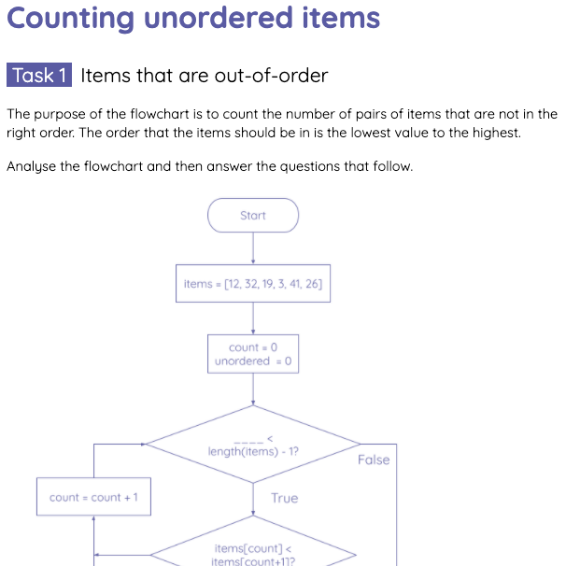
Counting unordered items
Activity 1
Look over the flowchart and answer the questions on the Activity 1 worksheet.

Slide 9

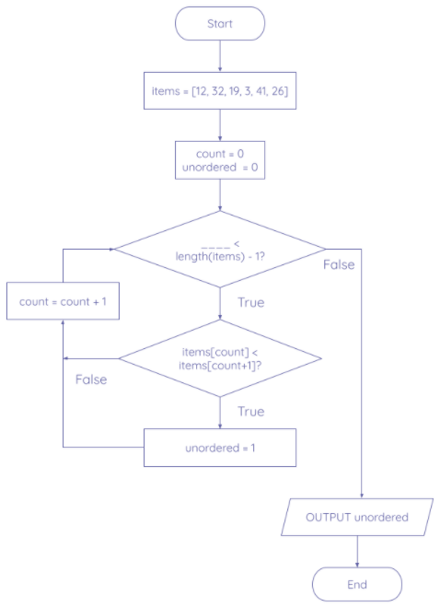
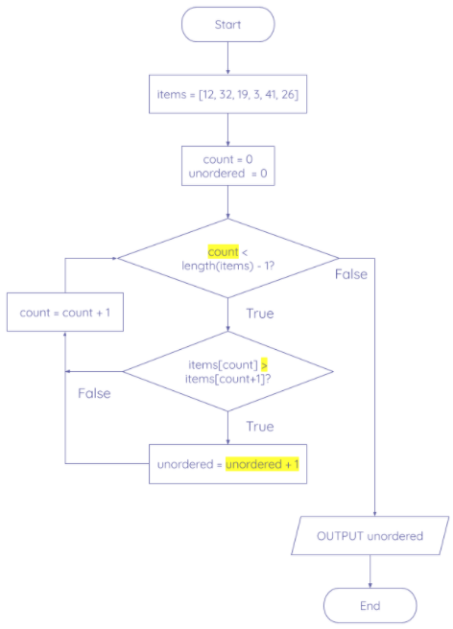
Counting unordered items - solution
Activity 1

Slide 10
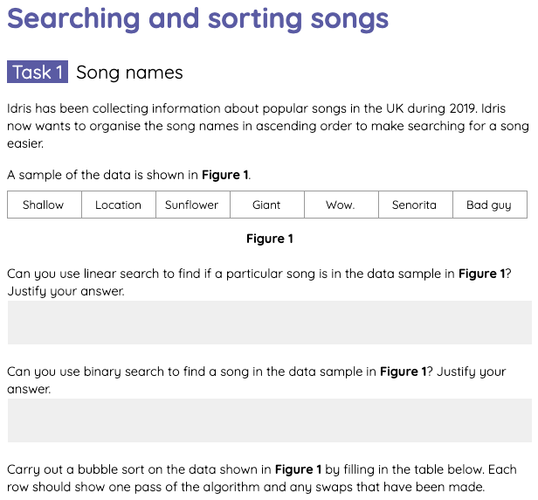
Searching and sorting algorithms
Activity 2
Complete the tasks on the Activity 2 worksheet on searching and sorting algorithms.

Slide 11
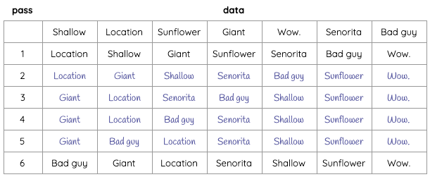
Searching and sorting - bubble sort solution
Activity 2

Slide 12
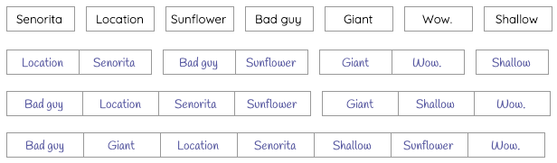
Searching and sorting - merge sort solution
Activity 2

Slide 13
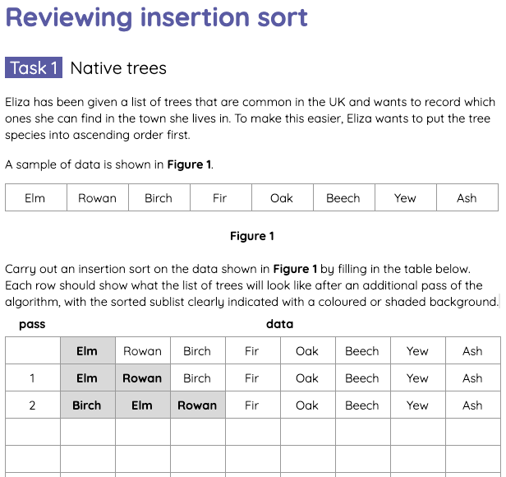
Reviewing insertion sort
Activity 3
Practice using insertion sort to order items by completing the tasks on the Activity 3 worksheet.

Slide 14
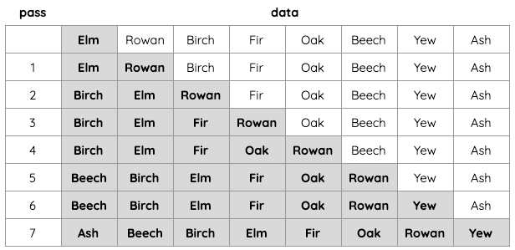
Reviewing insertion sort - solution
Activity 3

Slide 15
Comparing bubble sort and merge sort
Plenary
For each phrase, choose whether it refers to bubble sort or merge sort.
 | Bubble Sort or Merge Sort?
Splits data repeatedly until each item is in a list of its own.
Compares items next to each other in the list and swaps them if they are in the wrong order.
Creates a new list each time two lists are combined.
Poor at sorting large collections of unordered data.
Can be really quick to sort data that is nearly in order.
The algorithm is simpler to write.
A “divide and conquer” algorithm.
Merge sort
Bubble sort
Merge sort
Bubble sort
Bubble sort
Bubble sort
Merge sort

Slide 16
Comparing bubble sort and merge sort
Wrap Up
An advantage of merge sort over bubble sort is that it is faster to sort large lists and lists that are more unordered.
Bubble sort can actually be quicker than merge sort on smaller lists and lists that are mostly in order.
It goes to show that it is often not a “one size fits all” approach to sorting data!

Slide 17
Next lesson
Summary
In this lesson, you…
Interpreted algorithms and suggest improvements.
Analysed and fixed errors in a flowchart.
Performed searching and sorting algorithms on samples of data.
Next lesson, you will…
Take the summative test on algorithms.

